Slide 1


CAPSTONE PROJECT
Hotel Booking Cancellation & Revenue Insights Dashboard
Presented By
Student Name: Chandra diwakar
College Name: Noida institute of engineering and technology
Department: computer science
Email ID: 0231cs111@niet.co.in

Slide 2
OUTLINE:
Problem Statement (Should not include solution)
Proposed System/Solution
System Development Approach (Technology Used)
Algorithm & Deployment
Result (Output Image)
Conclusion
Future Scope
References

Slide 3
Problem Statement:
High cancellation rates and unpredictable booking behaviors in the hospitality industry lead to significant revenue loss and operational challenges.
Hotel management lacks a centralized, real-time view of key metrics like Average Daily Rate (ADR), optimal lead times, and booking channel performance.
Without data-driven insights, hotels struggle to optimize pricing strategies and manage inventory effectively during peak seasons.

Slide 4
Proposed Solution:
Overview: Develop a comprehensive Power BI dashboard to visualize hotel booking data, track cancellations, and analyze revenue metrics in real-time.
Data Collection: Utilize historical hotel booking datasets containing customer demographics, booking channels, stay duration, and revenue figures.
Data Preprocessing: Clean the raw data using Power Query to handle missing values, remove duplicates, and format data types correctly.
Deployment: Create interactive KPIs, slicers, and charts that allow management to track performance and make immediate data-driven decisions.

Slide 5
System Approach:
System Requirements: A standard PC with Windows OS, minimum 8GB RAM, and a stable internet connection. Primary Tool: Microsoft Power BI Desktop (for data modeling, visualization, and report generation). Data Processing Tools: Power Query Editor (for ETL - Extract, Transform, Load processes). Analytical Engine: DAX (Data Analysis Expressions) for creating custom measures and calculating KPIs.

Slide 6
Algorithm & Deployment:
Data Input & Modeling: Import raw CSV/Excel data into Power BI. Establish relationships between fact tables (bookings) and dimension tables (dates, channels) using a Star Schema model. Calculations (DAX): Formulate key performance indicators (KPIs) using DAX functions to calculate Total Revenue, Total Bookings, Cancellation Rate (%), and Average Daily Rate (ADR). Visualization: Design an interactive report canvas using Bar Charts, Donut Charts, and KPI Cards, integrated with Slicers for dynamic filtering by month and hotel type. Deployment Phase: Finalize the dashboard layout, apply a professional theme (Dark Mode), and export the final report to PDF format for submission as per LMS guidelines.

Slide 7
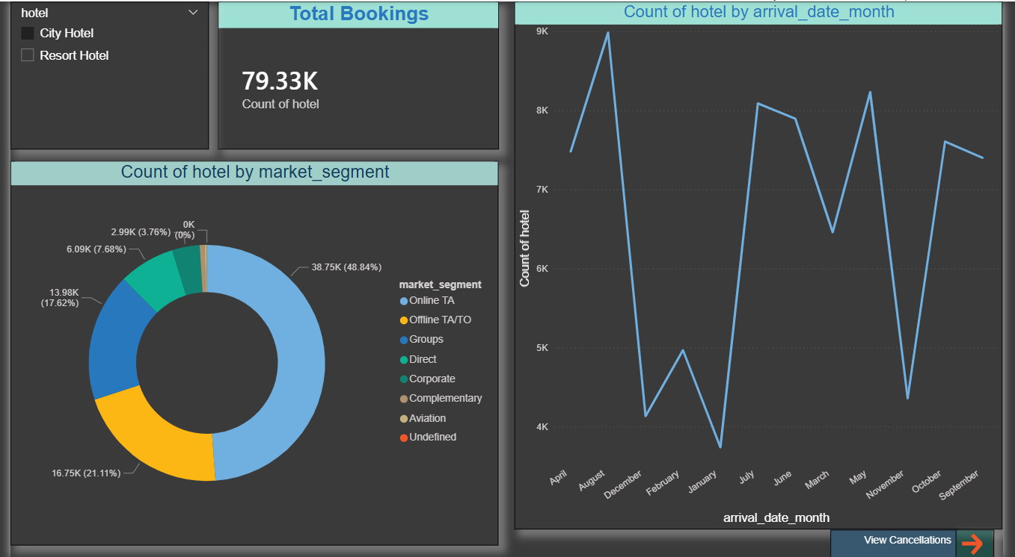
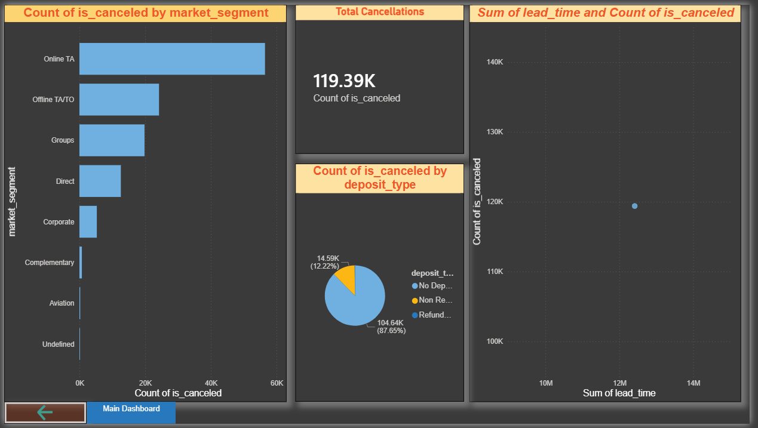
Result:

Slide 8
Conclusion:
The implemented dashboard successfully transforms scattered raw booking data into actionable, easy-to-understand visual insights. It clearly identifies which booking channels contribute to the highest revenue versus those with the highest cancellation rates. Management can now leverage these insights to adjust their cancellation policies, target profitable customer segments, and optimize overall hotel profitability.

Slide 9
Future scope:
Real-time Integration: The dashboard can be integrated directly with live Hotel Property Management Systems (PMS) or SQL databases for automated, real-time data refreshes. Predictive Analytics: Incorporate Machine Learning models to predict the probability of a user canceling a booking at the very moment they make a reservation. Sentiment Analysis: Expand the scope by connecting customer review data to correlate service quality and ratings with return booking rates.

Slide 10
References:
Microsoft Power BI Official Documentation for DAX and Power Query guidelines. Kaggle: Hotel Booking Demand Dataset (for historical data patterns). GitHub Link: Link

Slide 11
Thank You

